Slide 1
Technical Overview of the Startup Fundraising Platform

Slide 2

Introduction
Connecting Founders and Investors
The platform bridges the gap between startup founders and investors to foster meaningful collaborations.
Addressing Key Issues
Solves challenges like lack of transparency, inefficient communication, and limited global reach.
Focus Areas
Emphasizes security, usability, and scalability to ensure a seamless experience.

Slide 3

01
User Roles: Startup Founder, Investor, Admin.
02
Key Features: Registration, advanced filters, payment systems.
Functional Requirements
03
Startup Founder: Profile creation, document upload.
04
Investor: Browse startups, invest securely.
05
Admin: Approve profiles, monitor activities.

Slide 4

Non-Functional Requirements
Usability
An intuitive user interface ensures accessibility for both technical and non-technical users.
Reliability
The platform guarantees 99.9% availability and robust error handling.
Security
Compliance with GDPR and PCI DSS standards, alongside strong data encryption.

Slide 5

01
Frontend: React for a responsive UI.
02
Backend: Node.js for API requests and logic.
System Architecture
03
Database: PostgreSQL for secure data storage.
04
Hosting: Cloud-based for scalability.
05
Integration: Streamlined for seamless operation.

Slide 6

Use Case Scenarios
Startup Founder
Registers on the platform, creates a detailed profile, and uploads financial documents for admin approval.
Investor
Searches for startups based on filters, views profiles, and securely invests in opportunities.
Admin
Reviews and approves profiles, monitors platform activity, and resolves issues.

Slide 7
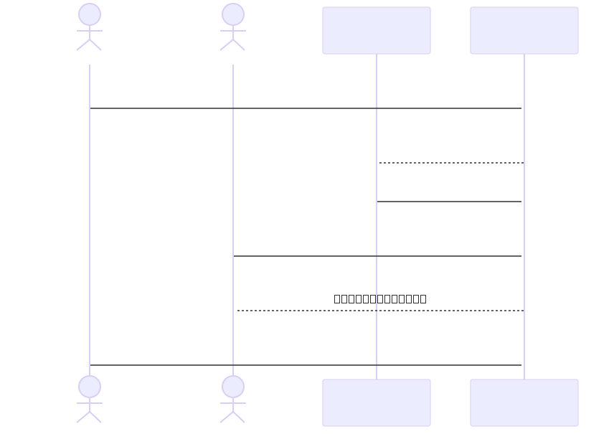
Startup Platform Use Case

Slide 8

Testing Overview
Test Types
Includes functional testing for specific functionalities, performance testing to ensure scalability, and security testing to protect sensitive data.
Results
Defects such as weak password validation and missing prompts were identified.
Improvements
Implemented solutions improved workflows and reinforced security measures.

Slide 9

01
AI-powered recommendations for investors.
02
Blockchain integration for transaction tracking.
Future Enhancements
03
Multi-language support for global accessibility.
04
Improved analytics for founders.
05
Enhanced security protocols.

Slide 10
Startup Fundraising Platform
What are the next steps for platform development?
Conclusion
A secure, scalable, and user-friendly platform tailored for startup investment needs, with room for enhancements and innovations.

Slide 11
Technical Overview
Any questions about the platform?
Thank You
Feel free to reach out for further details or collaboration opportunities.

